Slide 1
Hard disk DRIVE evolution

Slide 2
INTRODUCTION
Key characteristics of hdd, tending to upgrade through time:
Capacity
Data transfer and searching rate
Price per capacity unit
Physical size
Form factor
Interface

Slide 3
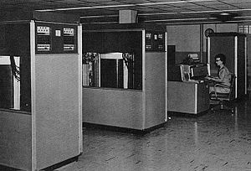
IBM 305 RAMAC (1956)
Capacity: 5MB
Consists of 50 24-inch-diameter disks
Price per megabyte > $10000

Slide 4
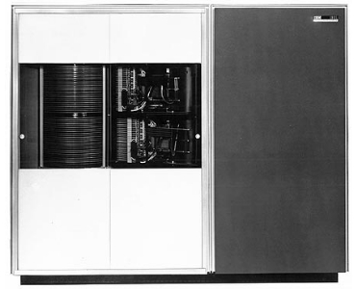
IBM 1301 disk storage unit(1961)
Capacity: 28 MB
Disk rotation speed: 1800 rpm
Price per megabyte: ~$4200

Slide 5
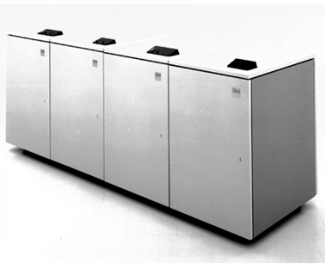
IBM 3340 direct access storage facility(1973)
Capacity: 70 MB
Access time: 25 ms
Data rate: 885 KB/s
Price per megabyte: ~$4200

Slide 6
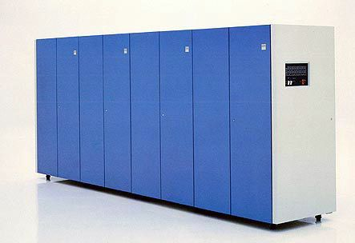
IBM 3380 Direct Access Storage Device(1980s)
Capacity: 2.52 GB
Data rate: 3MB/s
Price per megabyte: ~$47

Slide 7
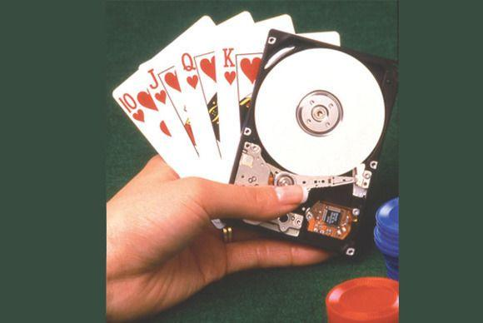
Toshiba Tanba hard drive(1990s)
Personal user HDD
Capacity: 63 MB
Form factor: 2.5’’

Slide 8
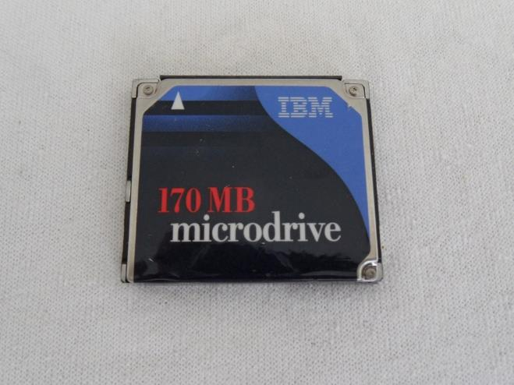
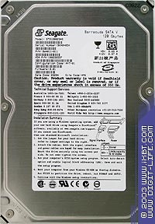
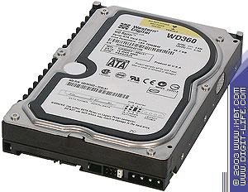
2000s
MICRODIRVE
Capacity: 170mb
1 inch in length
Price: ~$300
Seagate Barracuda ATA V
Capacity: 120GB
Price: $170
Interface: IDE
Form factor: 3.5’’
Western Digital Raptor
Disk rotation speed: 10000 rpm
Capacity: 37 GB
Data rate: ~5 ms
Price: ~$1000
Form factor: 3.5’’

Slide 9
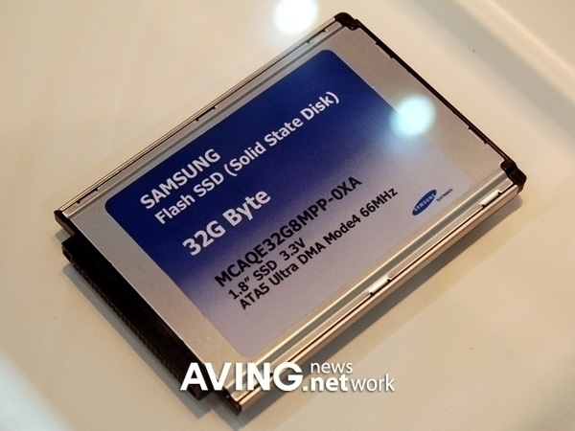
Solid state drives(2010s)
Samsung Flash SSD
Capacity: 32 GB
Price: ~$530
Data rate increase >30%
Form factor: 2.5’’

Slide 10
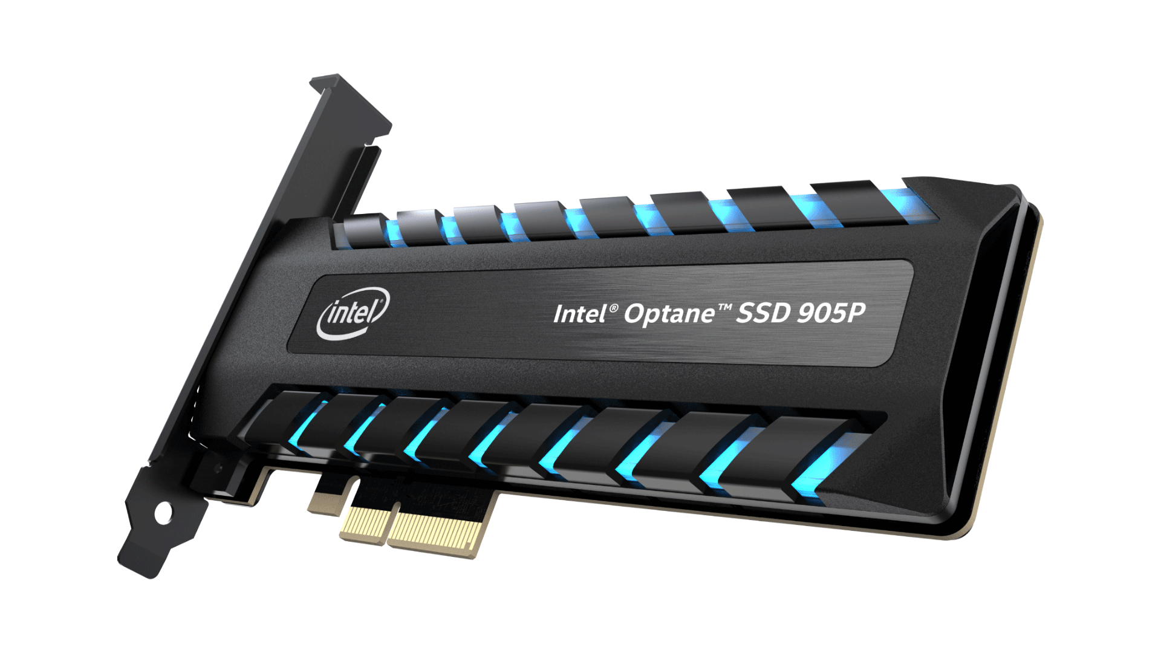
INTEL OPTANE 905P(CURRENT TIME)
Capacity: 960GB
Price: ~$1300
Data rate: up to 2600 MB/s

Slide 11
Hard disk drive capacity increase over time

